Slide 1
Rigid Body

Slide 2
Geometry
primitives (PxBoxGeometry, PxSphereGeometry, PxCapsuleGeometry, PxPlaneGeometry) where the geometry object contains all of the data
meshes or height fields (PxConvexMeshGeometry, PxTriangleMeshGeometry, PxHeightFieldGeometry), where the geometry object contains a pointer to a much larger object (PxConvexMesh, PxTriangleMesh, PxHeightField respectively)
You can use these objects with different scales in each PxGeometry type which references them
The larger objects must be created using a cooking process, described for each type below.

Slide 3
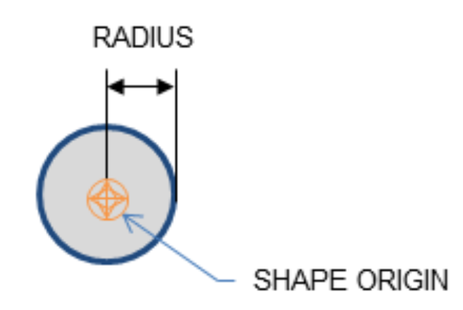
Geometry Types
Spheres

Slide 4
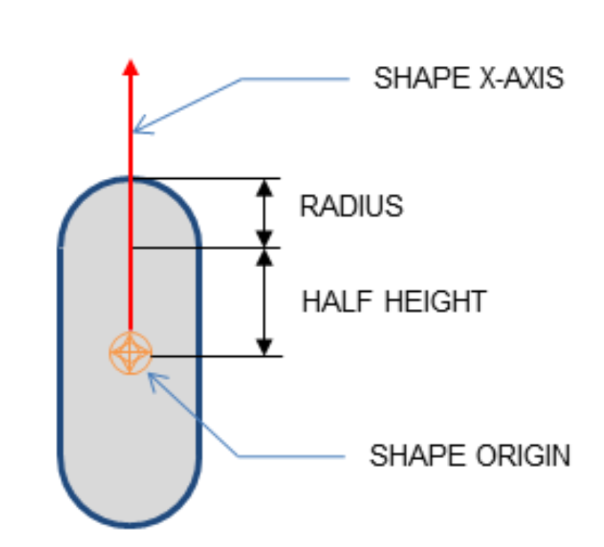
Capsules

Slide 5
PxRigidDynamic* aCapsuleActor = thePhysics->createRigidDynamic(PxTransform(position)); PxTransform relativePose(PxQuat(PxHalfPi, PxVec(0,0,1))); PxShape* aCapsuleShape = PxRigidActorExt::createExclusiveShape(*aCapsuleActor, PxCapsuleGeometry(radius, halfHeight), aMaterial); aCapsuleShape->setLocalPose(relativePose); PxRigidBodyExt::updateMassAndInertia(*aCapsuleActor, capsuleDensity); aScene->addActor(aCapsuleActor);

Slide 6
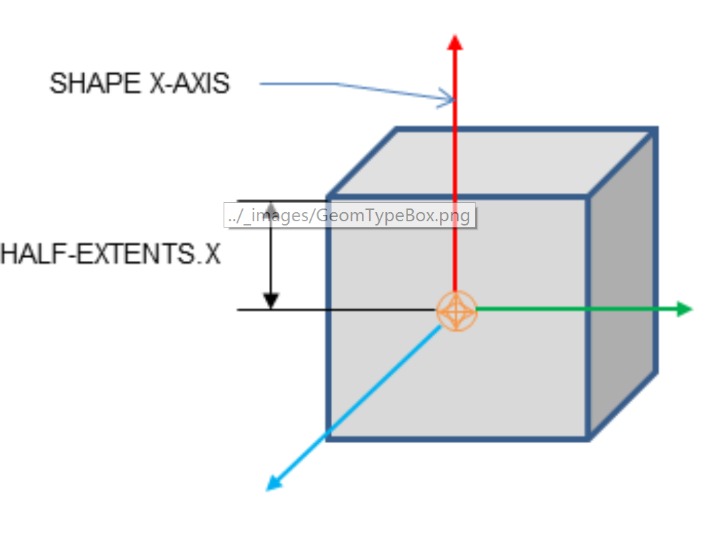
Boxes

Slide 7
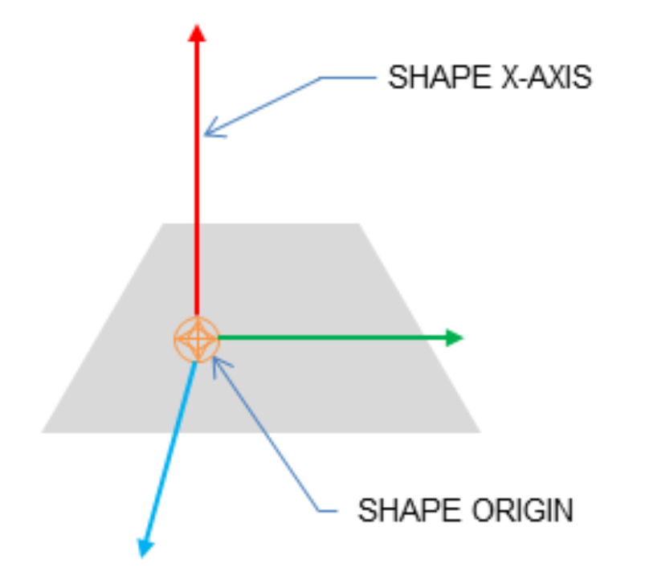
Planes
Notes:
Shapes with a PxPlaneGeometry may only be created for static actors.

Slide 8
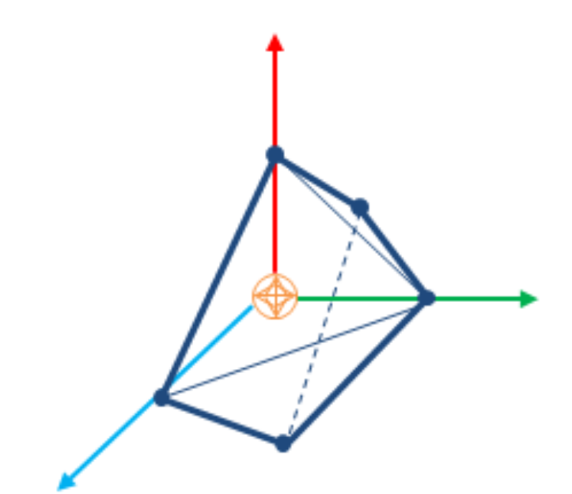
Convex Meshes

Slide 9
Creating a PxConvexMesh requires cooking. It is assumed here that the cooking library has already been initialized
The following steps explain how to create a simple square pyramid.
Notes:
A shape is convex if, given any two points within the shape, the shape contains the line between them. A PxConvexMesh is a convex polyhedron represented as a set of vertices and polygonal faces. The number of vertices and faces of a convex mesh in PhysX is limited to 255.

Slide 10
First, define the vertices of the convex object:
static const PxVec3 convexVerts[] = {PxVec3(0,1,0),PxVec3(1,0,0),PxVec3(-1,0,0),PxVec3(0,0,1), PxVec3(0,0,-1)};
Then construct a description of the convex data layout:
PxConvexMeshDesc convexDesc; convexDesc.points.count = 5; convexDesc.points.stride = sizeof(PxVec3);
convexDesc.points.data = convexVerts;
convexDesc.flags = PxConvexFlag::eCOMPUTE_CONVEX;
Now use the cooking library to construct a PxConvexMesh:
PxDefaultMemoryOutputStream buf; PxConvexMeshCookingResult::Enum result; if(!cooking.cookConvexMesh(convexDesc, buf, &result)) return NULL; PxDefaultMemoryInputData input(buf.getData(), buf.getSize());
PxConvexMesh* convexMesh = physics->createConvexMesh(input);
Finally, create a shape using a PxConvexMeshGeometry which instances the mesh:
PxShape* aConvexShape = PxRigidActorExt::createExclusiveShape(*aConvexActor, PxConvexMeshGeometry(convexMesh), aMaterial);

Slide 11
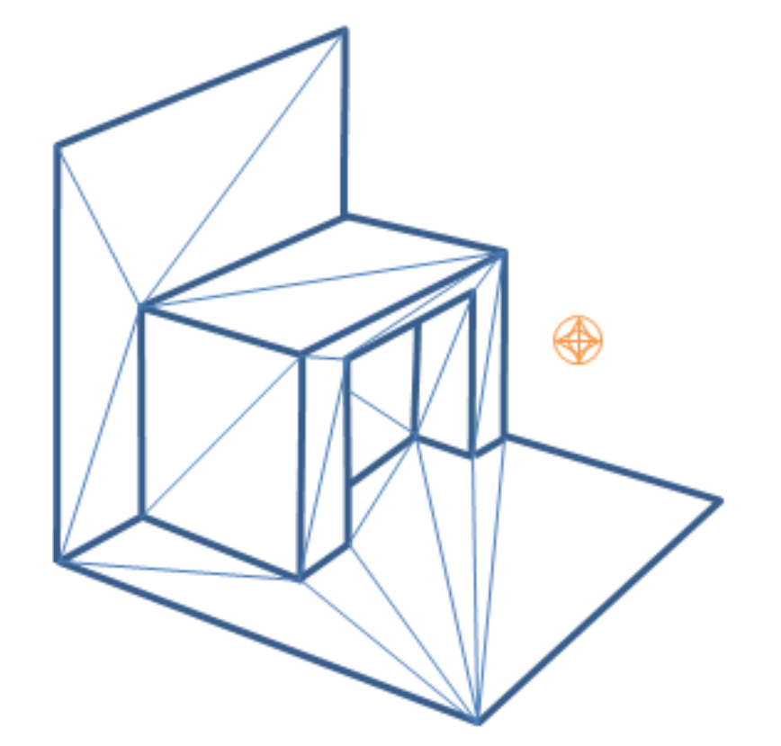
Triangle Meshes

Slide 12
Like graphical triangle meshes, a collision triangle mesh consists of a collection of vertices and the triangle indices. Triangle mesh creation requires use of the cooking library. It is assumed here that the cooking library has already been initialized

Slide 13
PxTriangleMeshDesc meshDesc;
meshDesc.points.count = nbVerts;
meshDesc.points.stride = sizeof(PxVec3);
meshDesc.points.data = verts;
meshDesc.triangles.count = triCount;
meshDesc.triangles.stride = 3*sizeof(PxU32);
meshDesc.triangles.data = indices32;
PxDefaultMemoryOutputStream writeBuffer;
PxTriangleMeshCookingResult::Enum result;
bool status = cooking.cookTriangleMesh(meshDesc, writeBuffer,result);
if(!status)
return NULL;
PxDefaultMemoryInputData readBuffer(writeBuffer.getData(), writeBuffer.getSize());
return physics.createTriangleMesh(readBuffer);

Slide 14
Alternatively PxTriangleMesh can be cooked and directly inserted into PxPhysics without stream serialization. This is useful if real-time cooking is required. It is strongly recommended to use offline cooking and streams. Example how to improve cooking speed if needed:

Slide 15
PxTolerancesScale scale;
PxCookingParams params(scale);
// disable mesh cleaning - perform mesh validation on development configurations
params.meshPreprocessParams |= PxMeshPreprocessingFlag::eDISABLE_CLEAN_MESH;
// disable edge precompute, edges are set for each triangle, slows contact generation
params.meshPreprocessParams |= PxMeshPreprocessingFlag::eDISABLE_ACTIVE_EDGES_PRECOMPUTE;
// lower hierarchy for internal mesh
params.meshCookingHint = PxMeshCookingHint::eCOOKING_PERFORMANCE;
theCooking->setParams(params);
PxTriangleMeshDesc meshDesc;
meshDesc.points.count = nbVerts;
meshDesc.points.stride = sizeof(PxVec3);
meshDesc.points.data = verts;
meshDesc.triangles.count = triCount;
meshDesc.triangles.stride = 3*sizeof(PxU32);
meshDesc.triangles.data = indices32;
#ifdef _DEBUG
// mesh should be validated before cooked without the mesh cleaning
bool res = theCooking->validateTriangleMesh(meshDesc);
PX_ASSERT(res);
#endif
PxTriangleMesh* aTriangleMesh = theCooking->createTriangleMesh(meshDesc,
thePhysics->getPhysicsInsertionCallback());

Slide 16
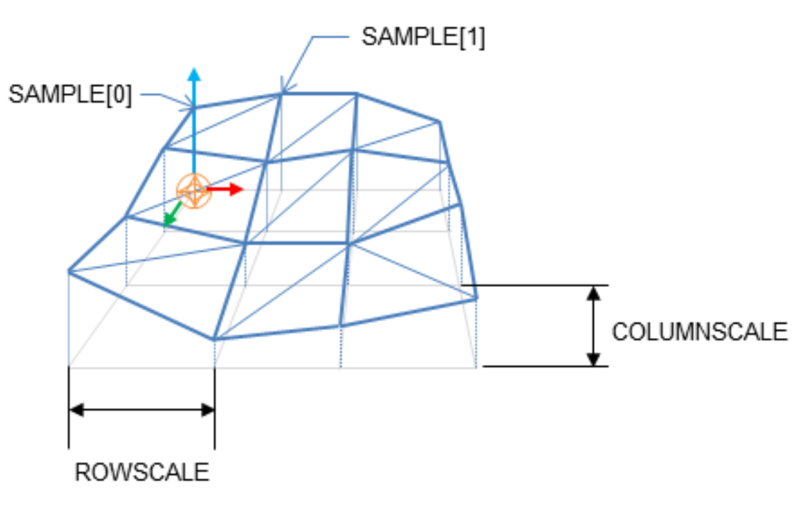
Height Fields

Slide 17
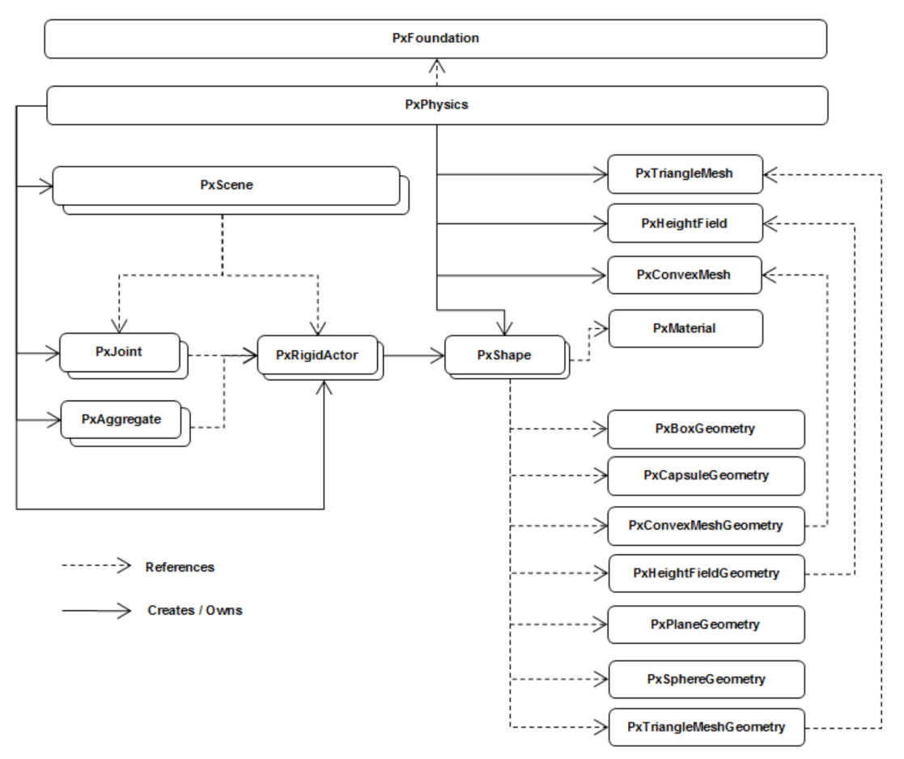
Rigid Body Object Model

Slide 18
Shapes
Shapes describe the spatial extent and collision properties of actors.
They are used for three purposes within PhysX: intersection tests that determine the contacting features of rigid objects, scene query tests such as raycasts, and defining trigger volumes that generate notifications when other shapes intersect with them.

Slide 19
Each shape contains a PxGeometry object and a reference to a PxMaterial, which must both be specified upon creation. The following code creates a shape with a sphere geometry and a specific material:
PxShape* shape = physics.createShape(PxSphereGeometry(1.0f), myMaterial, true);
myActor.attachShape(*shape);
shape->release();

Slide 20
Kinematic Triangle Meshes (Planes, Heighfields)
PxRigidDynamic* meshActor = getPhysics().createRigidDynamic(PxTransform(1.0f));
PxShape* meshShape;
if(meshActor)
{
meshActor->setRigidDynamicFlag(PxRigidDynamicFlag::eKINEMATIC, true);
PxTriangleMeshGeometry triGeom;
triGeom.triangleMesh = triangleMesh;
meshShape = PxRigidActorExt::createExclusiveShape(*meshActor,triGeom,
defaultMaterial);
getScene().addActor(*meshActor);
}

Slide 21
To switch a kinematic triangle mesh actor to a dynamic actor:
PxRigidDynamic* meshActor = getPhysics().createRigidDynamic(PxTransform(1.0f));
PxShape* meshShape;
if(meshActor)
{
meshActor->setRigidDynamicFlag(PxRigidDynamicFlag::eKINEMATIC, true);
PxTriangleMeshGeometry triGeom;
triGeom.triangleMesh = triangleMesh;
meshShape = PxRigidActorExt::createExclusiveShape(*meshActor, triGeom,
defaultMaterial);
getScene().addActor(*meshActor);
PxConvexMeshGeometry convexGeom = PxConvexMeshGeometry(convexBox);
convexShape = PxRigidActorExt::createExclusiveShape(*meshActor, convexGeom,
defaultMaterial);

Slide 22
Rigid Body Dynamics
Velocity
A body's linear and angular velocities can be read using the following methods:
PxVec3 PxRigidBody::getLinearVelocity();
PxVec3 PxRigidBody::getAngularVelocity();
A body's linear and angular velocities can be set using the following methods:
void PxRigidBody::setLinearVelocity(const PxVec3& linVel, bool autowake);
void PxRigidBody::setAngularVelocity(const PxVec3& angVel, bool autowake);

Slide 23
Applying Forces and Torques
void PxRigidBody::addForce(const PxVec3& force, PxForceMode::Enum mode, bool autowake);
void PxRigidBody::addTorque(const PxVec3& torque, PxForceMode::Enum mode, bool autowake);
void PxRigidBodyExt::addForceAtPos(PxRigidBody& body, const PxVec3& force,
const PxVec3& pos, PxForceMode::Enum mode, bool wakeup);
void PxRigidBodyExt::addForceAtLocalPos(PxRigidBody& body, const PxVec3& force,
const PxVec3& pos, PxForceMode::Enum mode, bool wakeup);
void PxRigidBodyExt::addLocalForceAtPos(PxRigidBody& body, const PxVec3& force,
const PxVec3& pos, PxForceMode::Enum mode, bool wakeup);
void PxRigidBodyExt::addLocalForceAtLocalPos(PxRigidBody& body, const PxVec3& force,
const PxVec3& pos, PxForceMode::Enum mode, bool wakeup);

Slide 24
Gravity
PxActor::setActorFlag(PxActorFlag::eDISABLE_GRAVITY, true);

Slide 25
Friction and Restitution
All physical objects have at least one material, which defines the friction and restitution properties used to resolve a collision with the objects.
To create a material, call PxPhysics::createMaterial():
PxMaterial* mMaterial;
mMaterial = mPhysics->createMaterial(0.5f, 0.5f, 0.1f); // static friction, dynamic friction,
// restitution
if(!mMaterial)
fatalError("createMaterial failed!");

Slide 26
实验
添加受力以及力矩
尽量鼠标交互的方式
物理材质
重力加速度
可以使用鼠标点选来取消或者添加重力加速度
探索一下，碰撞或者触发的进一步处理
比如子弹击中物体的得分

